Slide 1




Level 2 certificate in counselling skills
UNIT 1 – Core Skills
accredited by
&

Slide 2
Aims:
To Understand And Practise The 9 Core Counselling Skills
To Identify The Clients Need During The Session
Objectives:
Learning When To Use The Core Counselling Skills In A Helping Relationship

Slide 3
Online learners please note!
All activities completed from this Unit should be added to your Portfolio as evidence to demonstrate your knowledge and understanding of unit 1
Please make a copy of the blank sheets provided to record your answers.
Put your name, the date and the question with all submissions

Slide 4
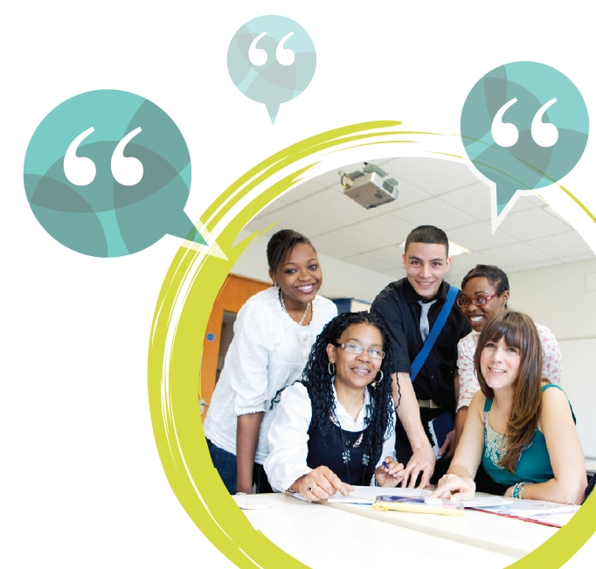
Explore ground rules
Explore Ground Rules With A Mind Map
Write Down Rules From Other Organisations
Combine And Create Ground Rules

Slide 5
Exploring ground rules for the distant learner
Assignments to be handed in on time.
Agreed font size of work sent in for marking.
Learner to take responsibility to request extra support when needed.
Learner available for agreed skype and phone sessions.

Slide 6
Exploring ground rules for the distant learner
Showing respect for the assessor
Mobile phone off during booked sessions
Learner to take responsibility for their own learning
At least 24 hours given to assessor for cancellation of agreed planned meetings.

Slide 7
Exploring ground rules for the tutor
Show respect and demonstrate respect by being a role model.
Teacher should show Consistency with ground rules and making sure learners know non-negotiables.
Teacher should not show discrimination, treating everyone fairly.
Setting good ground rules maintain accountability for Learner actions.

Slide 8
Explore: What is the difference between?
Counselling
and
Counselling Skills

Slide 9
9 Core Counselling Skills
Unconditional Positive Regard
Congruence/Genuine-ness
Empathic Understanding
Active Listening
Questioning
Paraphrasing
Reflecting
Summarising
Challenge

Slide 10
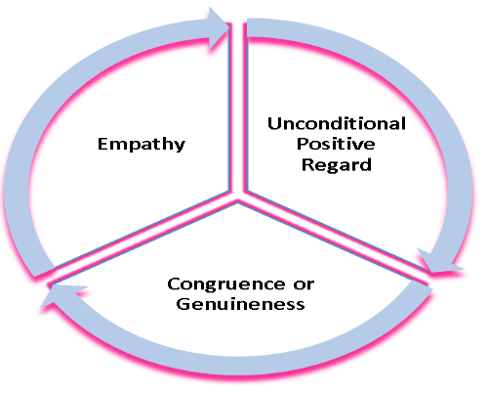
Carl Rogers and the Person Centred Approach
Empathy See their world through their eyes.
Respect/ Unconditional Positive Regard
UPR, acceptance, non-judgemental, non-possessive warmth, and prizing.
Congruence the helper is not playing a role but being themselves.

Slide 11

Unconditional Positive Regard
This requires that the skilled listener/counsellor to remove any form of personal judgment and except the client regardless of any content or disclosure they make.
It is human nature to judge and overcoming this instant reaction can be difficult but being able to accept a client unreservedly for who or what they area and allowing them to speak about their issues or problems without a fear of being criticised or judged is crucial to the relationship.
You as the listener may not approve of the clients’ actions but while with that client you need the approach of “I’ll accept you as you are”

Slide 12
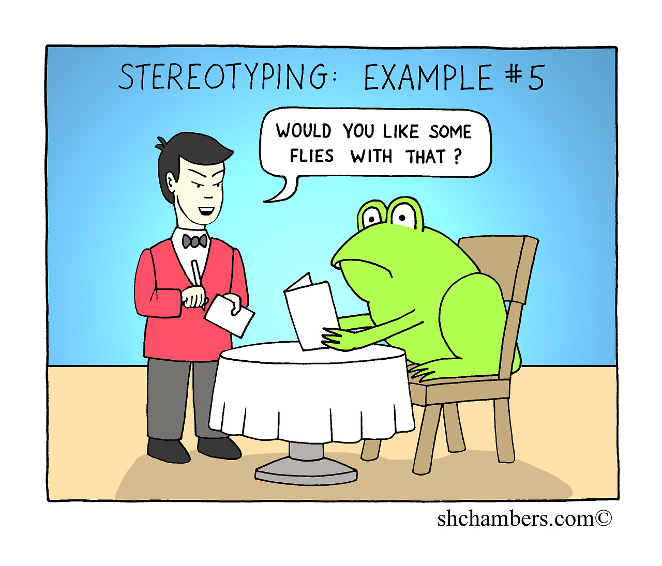
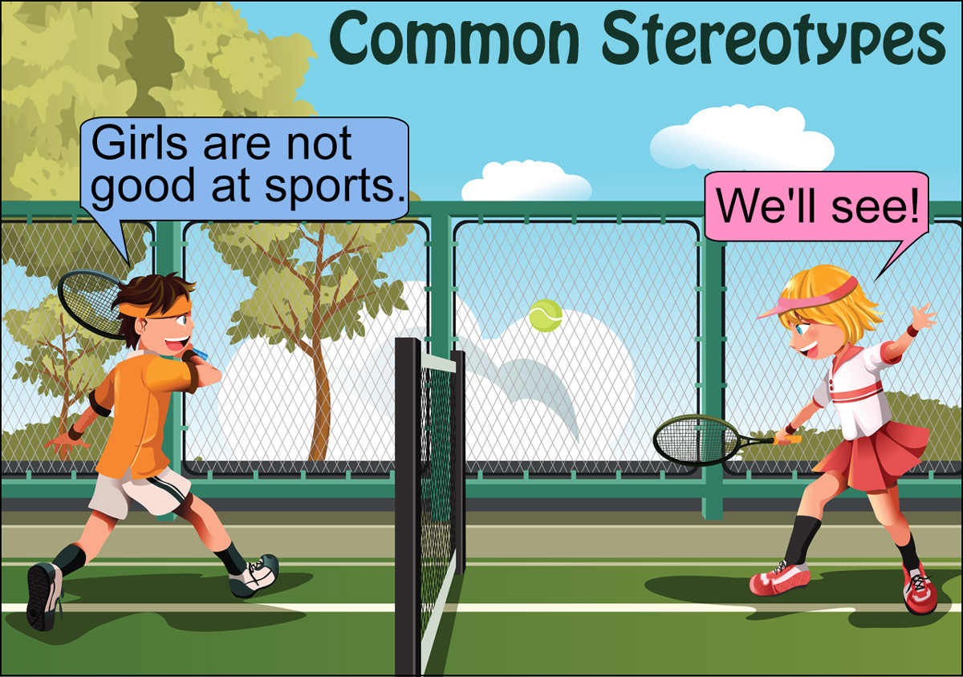
Exploring Stereotypes

Slide 13
Congruence/Genuine-ness
“In my relationships with other persons I have found that it does not help, in the long run, to act as though I were something I am not. It does not help to act calm and pleasant when actually I am angry and critical. It does not help to act as though I know the answers when I do not. It does not help to act as though I were a loving person if actually, at the moment, I am hostile. It does not help for me to act as though I were full of assurance, if actually I am frightened and unsure. Even on a very simple level I have found that this statement seems to hold. It does not help for me to act as though I were well when I feel ill”.
– Carl Rogers

Slide 14
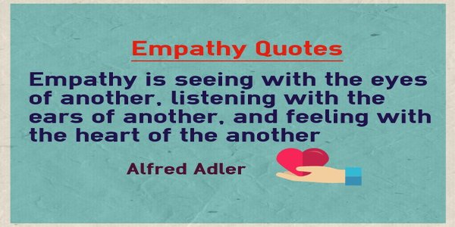
This
CC BY

